Slide 1

HPE Storage and Hybrid Cloud
Geert Kuijken, Enterprise Architect
October 2022

Slide 2
Agenda
Introduction: the world is hybrid
Bringing the cloud to you
HPE on-premise storage for the hybrid world
A promising start…

Slide 3
The world is hybrid
Modern cloud experience
On-premises reality
Speed and agility
Data gravity, latency, dependency, compliance
The world is and will remain hybrid …
… But we want the
cloud experience
Apps that can easily move to the cloud, already have
However, 70%
of apps and data remain
on premises, for good business reasons¹
¹ IDC Cloud Pulse Q119 June 2019 (includes on-premises non-cloud, on-premises private cloud, hosted private cloud)
Notes:
Cloud looks attractive for large amounts of data, flexible and speedy deployment of compute
Data has gravity; requires energy/time/effort to move it around – much remains on-premise.

Slide 4
Bringing the cloud to you
What does that mean?
Your cloud,
your way
You control
your data
Fast-forward your multi-gen IT
Unified experience,
everything as a service
Across edge to cloud, data lives wherever it maximizes business outcome
Sustainably accelerate transformation
with a global, principled partner
HPE GreenLake
Edge-to-Cloud platform
Powering data-first modernization
⁴
Notes:
So why HPE to help you solve these problems?
We bring you – your cloud your way
We allow you – to control your data
We enable you – to fast forward your multi-gen IT
All of this is brought to you by HPE GreenLake, our edge to cloud platform that powers data-first modernization
Through HPE GreenLake platform, we bring the cloud way of working to your datacenter, we don’t migrate your data to the cloud.
Cloud-hosted console that is lifecycle-managed by HPE: automatic updates to all the latest features and functionalities
Subscription-based, Pay-per-use services and/or infrastructure
No lock-in

Slide 5

On-premise IT for the hybrid world
Data growth, architecture complexity: Artificial Intelligence to the rescue

Slide 6





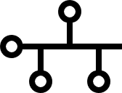

Simplify IT operations with AI
Self-Managing
Self-Healing
Self-Optimizing
Invisible IT
Storage
Servers
Networking
Converged
Data Mobility
Any Workload Optimized Platform
Any Consumption Model
Mission
critical
General
purpose
Secondary
Big
data
On-premises
SDS
Public cloud
Powered by HPE InfoSight - Autonomous and context-aware
Notes:
HPE Ultimate design goal: self managing-healing-optimizing infrastructure. InfoSight is the platform that will make it happen, providing intelligence layer and context needed to simplify infrastructure lifecycle management and support, making time-intensive monitoring unnecessary

Slide 7


HPE InfoSight: See once, prevent for all
Deep
insights:
Included with HPE intelligent storage portfolio
Host, VM, network,
application
Installed-base prevention
Problem resolution
5
4
Interop
Global correlation
Deep sensors
Config
Machine learning
HPE InfoSight
Installed base
Storage
1
2
3
Data analysis
Case
creation
Root cause
analysis
Non-best practices
Notes:
We have this saying - see once and prevent for all, which means if we see a problem in any customer environment, we make sure no other customer will see the same problem.
If InfoSight detects a problem, it is able to generate a fingerprint and scan its install base using pattern recognition and predict if any other system will be susceptible. This can remediate future problems and eliminate any performance, availability or security problems before they occur.
Don’t wait for a problem to occur: InfoSight is available 24/7 to assist in planning your infrastructure evolutions, optimizing your current use, …

Slide 8
HPE InfoSight works cross-stack
Storage insight alone is ineffective: include virtualization and compute layers
More than
90%
of problems
arise from above the storage layer
Virtualization
100s of Variables
Server
Network
Reliable & Fast Storage solves only fraction of the problem
Storage
IDC, Server and Storage Availability Survey Results, April 2019
Notes:
Our POV is that storage resiliency by itself is ineffective.
Complexity outside the storage stack is higher than inside: multi-vender by default, more versions, more firmwares/drivers ... Need highly skilled admins
Automatic case creation for HPE Compute via integration with iLO5 management processor

Slide 9
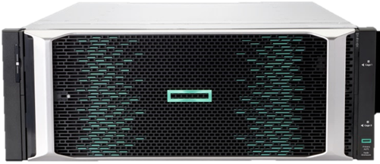
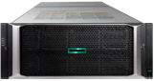
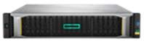



HPE intelligent storage portfolio
HPE MSA
HPE Alletra 5000
HPE Alletra 6000
HPE Alletra 9000
HPE XP
Moving from DAS to SAN
Customer is looking for
entry FC/SAS or mixed
host connectivity
ROBO
General Purpose Apps
Hybrid Flash Array
99.9999% Uptime
AI-driven
Business Critical Apps
All-NVMe Array
99.9999% Uptime
AI-driven
Mission Critical Apps
All-NVMe Array
100% Availability Guaranteed
AI-driven
High-End Storage for traditional datacenters Mainframe & HPE NonStop Mission Critical Apps
99.999999% Availability
HPE InfoSight
HPE SimpliVity
HPE Apollo 4000
HPE StoreOnce
Hyper-Converged
with DR/BC
Big Data, Scale-out
Workloads
Secondary
Workloads
Notes:
HPE delivers a comprehensive portfolio of the world’s most intelligent storage.
We provide workload optimized storage for enterprise apps, data protection, and big data that’s build for cloud with native replication. Infosight brings Predictive analytics and AI for Data Center and HPE Greenlake delivers flexible consumption options that meet business needs.

Slide 10
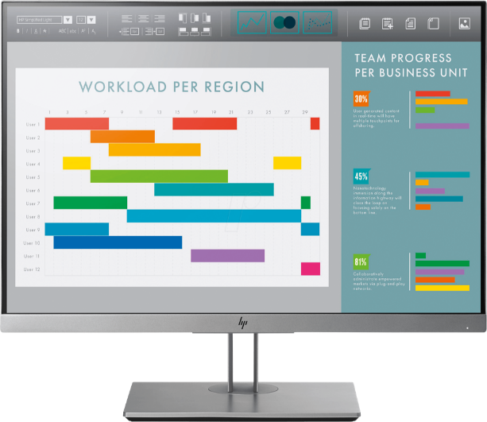
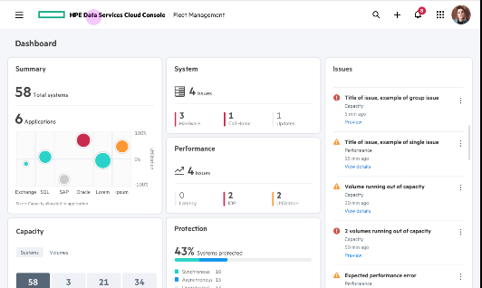

HPE intelligent storage portfolio: HPE InfoSight is just the beginning
HPE Alletra 5000
HPE Alletra 6000
HPE Alletra 9000
AI-driven
Global
Intelligence
From a cloud-instance
AI-Ops
Data Services
Infrastructure Services
General Purpose Apps
Hybrid Flash Array
99.9999% Uptime
AI-driven
Business Critical Apps
All-NVMe Array
99.9999% Uptime
AI-driven
Mission Critical Apps
All-NVMe Array
100% Availability Guaranteed
AI-driven
HPE InfoSight
HPE SimpliVity
HPE Apollo 4000
HPE StoreOnce
Hyper-Converged
with DR/BC
Big Data, Scale-out
Workloads
Secondary
Workloads
Notes:
HPE delivers a comprehensive portfolio of the world’s most intelligent storage.
We provide workload optimized storage for enterprise apps, data protection, and big data that’s build for cloud with native replication. Infosight brings Predictive analytics and AI for Data Center and HPE Greenlake delivers flexible consumption options that meet business needs.

Slide 11
Introducing the cloud operating model for on-premise storage
HPE Data Services Cloud Console vision: simplify IT operations
Example Data Services
ACCESS
PROTECT
SEARCH
MOBILIZE
Example Infrastructure Services
DEPLOY
MANAGE
UPGRADE
OPTIMIZE
Assisted by HPE InfoSight AI
Subscription for
HPE Data Services
Cloud Console
Notes:
Intent of slide: Introduce the Data Services Cloud Console
Data Services Cloud Console is designed to simplify and integrate data operations with a single destination for a comprehensive set of data and infrastructure services.
Data Services Cloud Console cloud infrastructure services radically simplify how customers manage infrastructure at scale across the lifecycle—from simplified deployment, to automatic optimized app deployment across a customer’s fleet, to later in the year cloud delivered invisible upgrades.
Data Services Cloud Console’s suite of integrated, automated and policy driven cloud data services will enable comprehensive data orchestration across its lifecycle—from test/dev, production, protection, to analytics—collapsing data silos and eliminating the complexity of traditional data management operations. This will equip organizations with the one data experience they need to accelerate data-driven innovation, protect data everywhere, and intelligently move data across clouds.

Slide 12
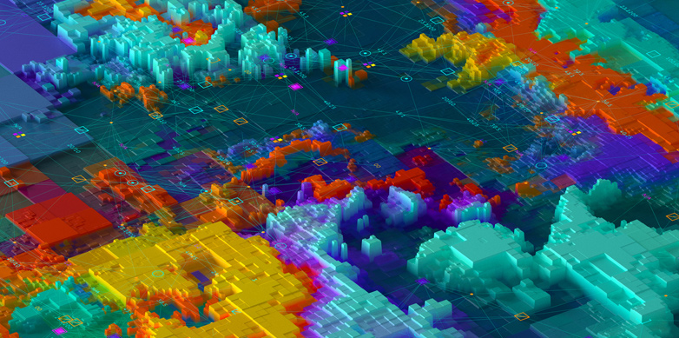
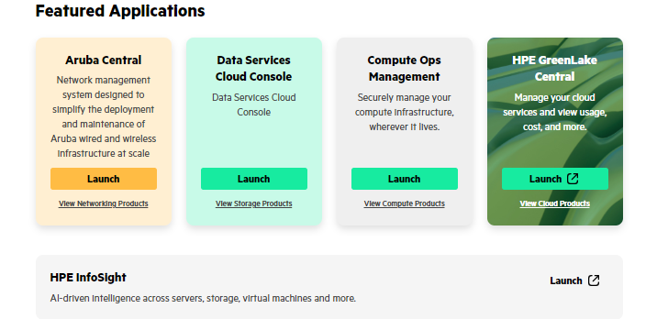
Hosted on the HPE GreenLake Common Cloud Platform
The platform provides a set of common functionality that unifies your experience across all the HPE GreenLake services you consume:
HPE GreenLake Edge-to-Cloud Platform
Account management / customer signup
User authentication
Role-based access control
Quoting and ordering
Subscription / entitlement management
Managed Service Provider workflows
API and CLI standards
Notifications
Monthly billing
Device inventory management
Tagging
The apps and services that run on the platform make use of this functionality to solve business use cases
Notes:
Intent of this slide: Distinguish between the platform itself and the applications and services that run on it. Explain which specific functionality is provided by the platform, which is leveraged by all apps/services running on the platform, providing a consistent user experience.
Much of the value a user gets from the HPE GreenLake edge-to-cloud platform will come from the apps and services that run on the platform. Those apps and services depend on the following features and functions in the platform itself:
Account management, from company details such as primary contact information to establishing organizational hierarchies
User authentication, including the ability for you to set up single sign-on (SSO) with your own identity provider
Role-based access control (RBAC) that let you save time for most users with assignable roles and groups, but give you the granular control of specific permissions when needed
Quote and order services right from the platform, decreasing your time to value with HPE GreenLake
Track and manage your subscriptions, extending them or expanding capacity when needed and purchasing new subscriptions right from the platform
Managed Service Provider (MSP) workflows that enable an MSP to set up the platform for their customers
Standards for application programming interfaces (APIs) and command line interfaces (CLIs) that make integrating with HPE GreenLake more predictable and scalable
The ability for HPE to notify specific groups of users about maintenance windows, new functionality, or other news that affects them
A consolidated invoice for HPE GreenLake services, available to both customers and partners in multiple formats (this is a future capability)
Device inventory management that enables you to view and manage devices by application, subscription, and more
The ability to tag resources with identifiers that are relevant to your business. These tags surface in apps and services on the platform including fleet management and billing, enabling you to view and manage your cloud services in business terms.

Slide 13
A promising start
On the road to “everything you want as a service”

Slide 14










HPE Intelligent Data Platform architecture
HPE GreenLake for storage and data protection
AI-driven
Global
Intelligence
DATA
SERVICES
Analytics
Security &
Compliance
Backup &
Recovery
Disaster
Recovery
TBA
TBA
TBA
INFRASTRUCTURE SERVICES
Fleet
Manager
Policy
Manager
HCI
Service
Block
Storage
Storage Fabric
Manager
TBA
TBA
HPE Alletra 5000
HPE Alletra 6000
HPE Alletra 9000
CLOUD-NATIVE INFRASTRUCTURE
HPE dHCI
HPE Nimble HF
HPE Nimble AF
HPE Primera
Notes:
Intent of slide: Reinforce the value of HPE GreenLake for storage and data protection.
HPE’s portfolio of cloud data services, cloud infrastructure services and cloud-native data infrastructure, powered with data-driven intelligence, helps customers accelerate their data-first modernization.
HPE GreenLake for storage and data protection accelerates the delivery of the cloud operational experience so customers can unleash agility, be freed to Innovate and reduce risk.
TRANSITION:
Let’s look at different ways we’re helping customers today

Slide 15
HPE GreenLake for Block Storage
A storage service from HPE, self-managed through HPE DSCC
1
2
3
4
Select
Availability
tier
Select
Performance level
Select
Reserved capacity
Select
Subscription term
You select outcomes - we deliver them on-premise
Ownership of the hardware resides with HPE
Onboarding and invisible upgrades provided by HPE
You subscribe to and consume storage as a service
Intent-based provisioning engine
Billed in arrears for a fixed price GB/month

Slide 16

HPE GreenLake for HCI
Hybrid Cloud from HPE, self-managed through HPE DSCC
HPE GreenLake for HCI
VMs across Hybrid Cloud, on demand
Subscription-based consumption of
VMs and infra as-a-service on
HPE dHCI stack and AWS
Manage on-prem and AWS VMs with a
unified cloud experience
1-click full stack upgrade
Simplify hybrid cloud protection:
  Integrates with separate
  HPE GreenLake for Backup and
  Recovery Service
1-stop VM to infra management across hybrid cloud
1-click multi-system deployment with Blueprints
1-click multi-site upgrades
Cloud–based VM Management across Hybrid Cloud
VM
VM
VM
VM
VM
VM
EC2
EC2
EC2
COMPUTE
COMPUTE
COMPUTE
NETWORK
NETWORK
NETWORK
STORAGE
STORAGE
STORAGE
ON-PREM CLOUD
EDGE CLOUD
AWS CLOUD
Build your self-service private cloud on demand where you need it
Notes:
The customer/partner will be asked to make the following wizard-driven decisions to create a quote and order the service:
Service tier: Business-critical, General purpose
Resource reservations: storage capacity, compute resources, memory resources. Units of measure: usable GB storage capacity, compute CPU cores, memory.
Environmental requirements
Subscription term: Three years only at launch (more options to be available in the future)

Slide 17
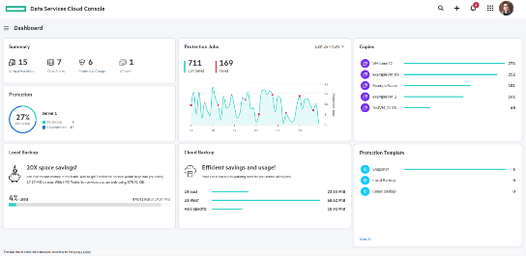



HPE GreenLake for Backup and Recovery Service
A storage service from HPE, self-managed through HPE DSCC
Extremely easy to use
Tiered data Protection
Across Hybrid Cloud (in beta)
  Allocate VMs to Protection Groups
  Configure and apply global protections policies
  Supports AWS EC2 instances, or EBS volumes
  Tier data to meet diverse SLAs
  Cost efficient, scalable LTR
  Protect any VM on any storage
  Protect AWS Compute
  Same policies, same interface, same benefits
On-Prem
Cloud
HPE Backup and Recovery Service cloud console
Customer AWS Cloud Environment
EC2
DSCC managed
storage
Any Storage
EBS
Array Optimized
or CBT Backup
CBT Backup
Instant Recovery
from local snapshots
Rapid Recovery
from on-prem backups
Long-Term Retention (LTR)
via cost-effective backup to cloud
Rapid Recovery
from AMI or EBS Snapshots
Notes:
Intent of the slide: Explain how the service protects AWS resources
One service to protect data across hybrid cloud –with a single management console
Ability to protect AWS EBS Volumes using AWS Snapshot and Catalyst backups, EC2 using Amazon Machine Image (AMI) and Catalyst Backups.
Ability to protect resources using AWS-Tags and other attributes. AWS-Tags can be created and applied from the service
Ability to consolidate, protect and visualize multiple AWS accounts
Pay per protected VM and per landed capacity in HPE cloud – after dedupe & compression via ultra-efficient HPE Catalyst technology: up to 5x more efficient than others.
Immutable data copies for ransomware protection

Slide 18

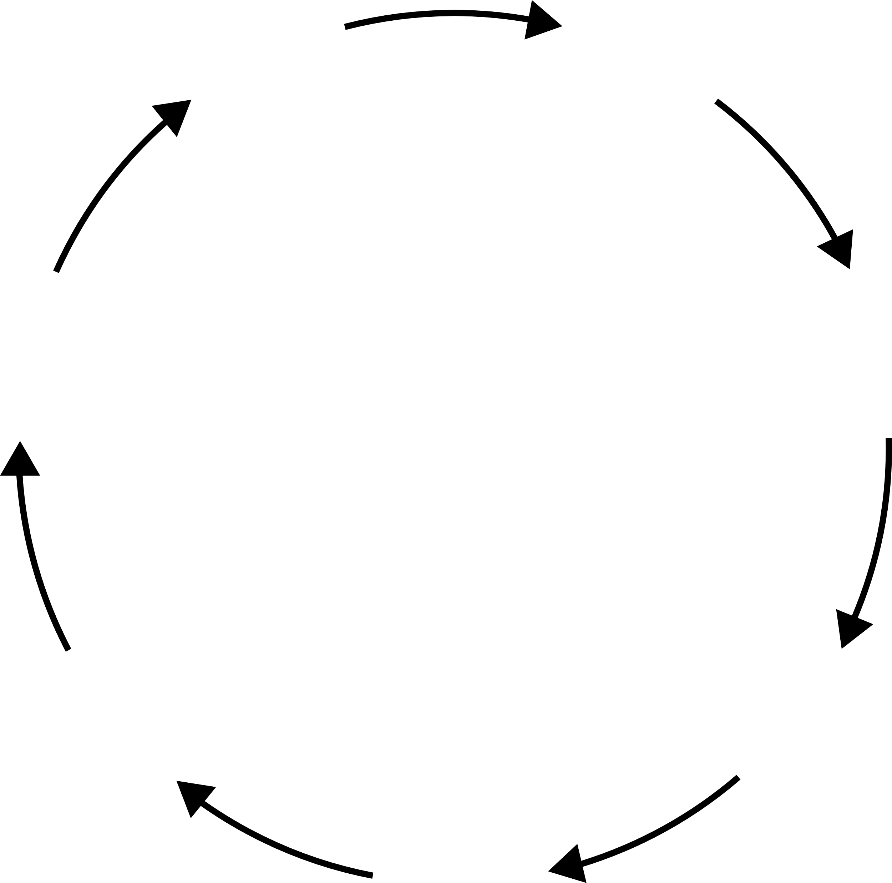






Vision: manage the entire lifecycle through a single unified console
Order
Configure
& Deploy
Refresh
Compliance & Governance
Support
Manage
Monitor & Analyze
Notes:
Intent of Slide: Illustrate the long-term vision HPE GreenLake for xxx
- Focus on the comlete life cycle instead of just elements
- For the entire environment, edge to cloud
- In one cloud-based console
Trough cloud-native development new features will be added over time in a non-disruptive way for the subscribers.

Slide 19
Thank you
Geert.Kuijken@hpe.com

